Slide 1
No Peanut Butter & Jelly

Slide 2
Note: After you download the slideshow, you may also need to download some videos from YouTube & add them into this PowerPoint. This tool can help you: Free YouTube Download
We present these messages in outdoor venues using the SonShineTent. Watch the video of our service that goes with this message, click here: http://campaignkerusso.org/?p=13396
We would love to know more about the people who download our lessons & sermons. We invite you to email us & let us know where & how you use them.
info@campaignkerusso.org

Slide 3
Welcome All

Slide 4
Let’s Begin with Prayer

Slide 5
No Peanut Butter & Jelly

Slide 6
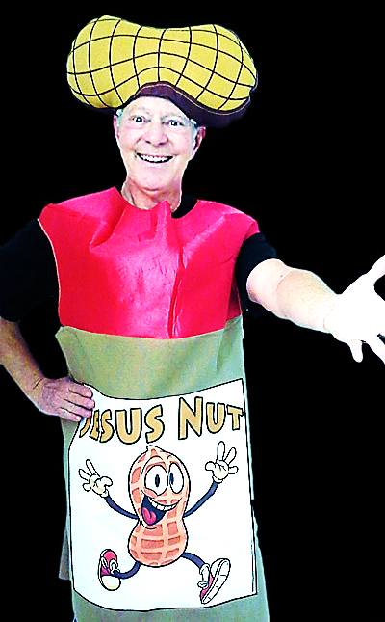
Let’s all give a warm welcome to…
The Jesus Nut

Slide 7
Song: Peanut Butter & Jelly
Video Goes Here Title: Peanut Butter & Jelly Download Here:
https://youtu.be/klDHM_sxYxs

Slide 8
No Peanut Butter and Jelly

Slide 9
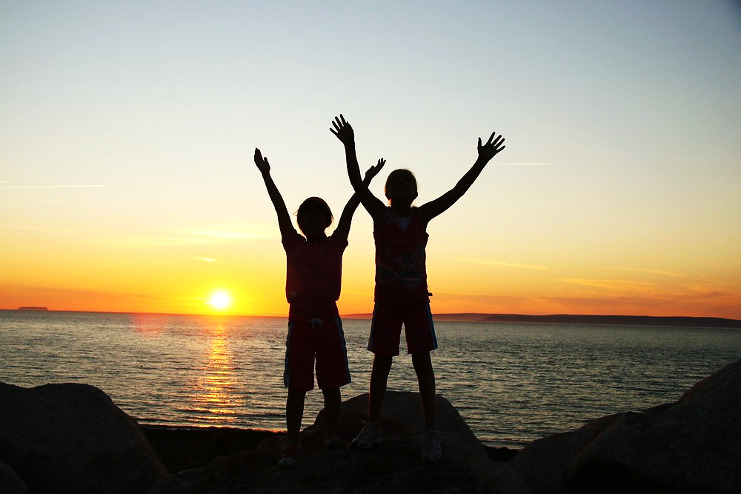
We’re going to learn a song…
Let’s Learn the Actions

Slide 10
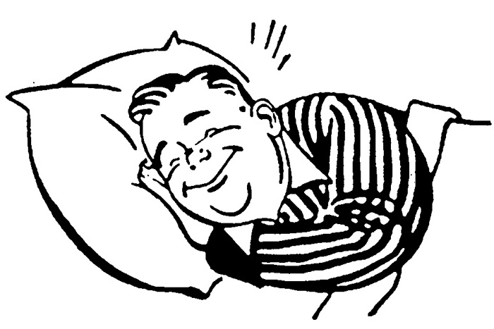
Give me Jesus in the morning

Slide 11
Give me Jesus in the evening

Slide 12
Every minute of the day…

Slide 13
Give me Jesus

Slide 14
He’s my reason for living

Slide 15
He’s my source of survival

Slide 16
Every minute of the day…

Slide 17
Give me Jesus

Slide 18
Song: Give Me Jesus
Video Goes Here Title: Give Me Jesus Download Here:
https://youtu.be/P5HuOsV-6Tc

Slide 19
Who wants to see a Nutty magic trick?

Slide 20
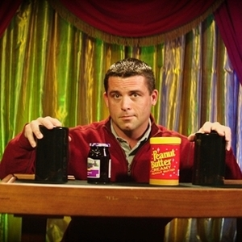
You can buy this Magic Trick Here: http://stores.silkmagictricks.com/products/peanut-butter-and-jelly-illusion-pro-model.html?gclid=CjwKEAiAmo_CBRC9qbGQssjqi28SJABYTgZxhErgePDb3SEl7MOCv0gqQanjTJtNrDjo_LGzilVq8RoC2Mnw_wcB

Slide 21
Nutty Magic Trick Music
Download here: https://youtu.be/psN0jkAY1lI

Slide 22
Did you watch closely?
What did you see happen?
Why is food (like this peanut butter & jelly) so important to us?
Are you hungry right now?
Questions:

Slide 23
Who wants some peanut butter and jelly crackers right now?

Slide 24
Song: The Time Jesus was Hungry
Video Goes Here Title: The Time Jesus was Hungry Download Here:
https://youtu.be/ag8Npzs7mXY

Slide 25
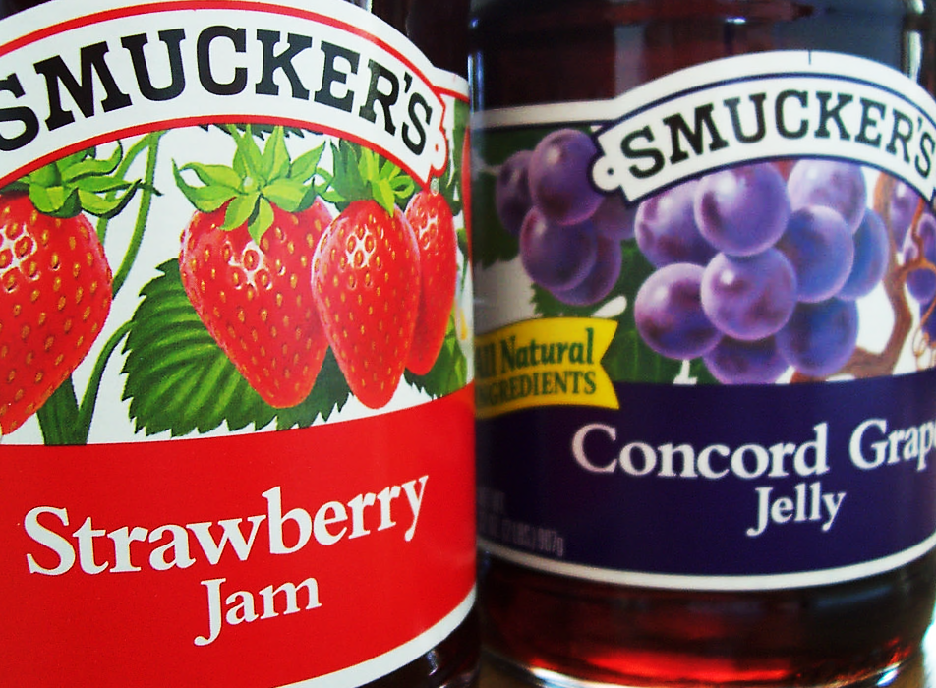
Did you know there are two kinds of foods and two kinds of hunger?

Slide 26
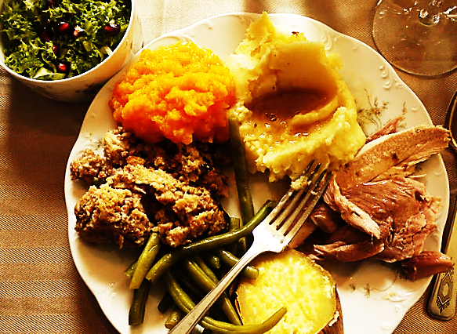
One kind of food feeds our bodies…
The other
feeds our souls

Slide 27
One makes us bigger…
The other makes us better

Slide 28
One saves our lives today…
The other saves our souls forever.

Slide 29
Jesus is Food for the Soul
“He who comes to me will never go hungry.”

Slide 30
Jesus also said:
“He who comes to me will never thirst.”
He who comes to me will never go hungry

Slide 31
Song: No Peanut Butter & Jelly
Video Goes Here Title: No Peanut Butter & Jelly Download Here:
https://youtu.be/2kQGAXRSn-s

Slide 32
What are the two kinds of hunger?
What are the two kinds of food?
What did the mother think her son wanted?
What did he really want?
Why did he want Jesus more than peanut butter and jelly?
Questions:

Slide 33
Is Jesus
Speaking to You?
“They said to each other, ‘Did not our hearts burn within us while he talked to us on the road, while he opened to us the Scriptures?’”
John Wesley Said:
“…the preacher was describing the change which God works in the heart through faith in Christ and I felt my heart strangely warmed.”
Jesus makes His presence Known by a small voice!

Slide 35
What is the Sinner‘s Prayer?
This is a prayer we can pray when we are ready to admit we are sinners and need Christ’s forgiveness.
It must be prayed with faith in our hearts and a readiness to have a life-changing encounter with Jesus Christ.

Slide 36
A prayer of faith → Pray this prayer if :
If you never have before
You have in the past, but you think it would mean more today
You have been walking afar off and you want to come back
You want to set an example & show others how it is done
You just like to give your heart to Jesus again & again
Faith

Slide 37
We Declare Our Faith Publicly Because Jesus Declared His LOVE Publicly
“If you stand before others and are willing to say you believe in me, then I will tell my Father in heaven that you belong to me.” Mat 10:32

Slide 38
Three Important Questions
Do you want to know Jesus as your Savior right now?
Do you believe He died to save you from your sins & that He rose from the dead?
Do you believe that He is here, waiting to save you right now?

Slide 39
The Prayer of a Sinner Turning to Jesus
Dear Jesus, I know that I have sinned against You and that my sins separate me from You.
I am truly sorry.
Right now, I turn away from my sinful past .
Please forgive me, and help me to keep from sin.
I believe You died for my sins.
I Believe You rose from the dead, you are alive, and you hear this prayer from my heart.
I invite You Jesus to be both my Savior and the Lord of my life.
I want You to rule my life from now on.

Slide 40
“But some people did accept him. They believed in him, and he gave them the right to become children of God.”
John 1:12

Slide 42
“If you openly say, ‘Jesus is Lord’ and believe in your heart that God raised him from death, you will be saved.”
Rom. 10:9
What did you learn today?
Why is Jesus better than peanut butter and jelly?
What have you been thinking about God lately?
What do you want to tell the world about Jesus?

Slide 43
Let’s Close in Prayer

Slide 44
Note: After you download the slideshow, you may also need to download some videos from YouTube & add them into this PowerPoint. This tool can help you: Free YouTube Download
We present these messages in outdoor venues using the SonShineTent. Watch the video of our service that goes with this message, click here: http://campaignkerusso.org/?p=13396
We would love to know more about the people who download our lessons & sermons. We invite you to email us & let us know where & how you use them.
info@campaignkerusso.org

